Slide 1
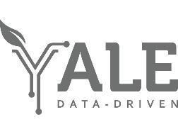

Hackaton 2.0
Statistical thinking
Diego Manya
Yale School of Forestry and Environmental Studies
Yale Data Driven Solutions Group
March 16th, Yale -NUS
Notes:
How can we meet SDG 11 if we can’t measure it?
How can we make an index that is applicable in diverse cities?

Slide 2
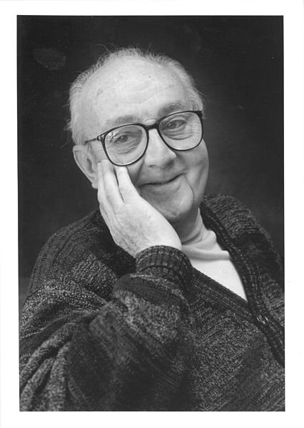
A Word from Grandpa Stats
…cunningly chosen parsimonious models often do provide remarkably useful approximations.
….
For such a model there is no need to ask the question "Is the model true?". If "truth" is to be the "whole truth" the answer must be "No". The only question of interest is "Is the model illuminating and useful?
George E.P. Box (1979)

Slide 3
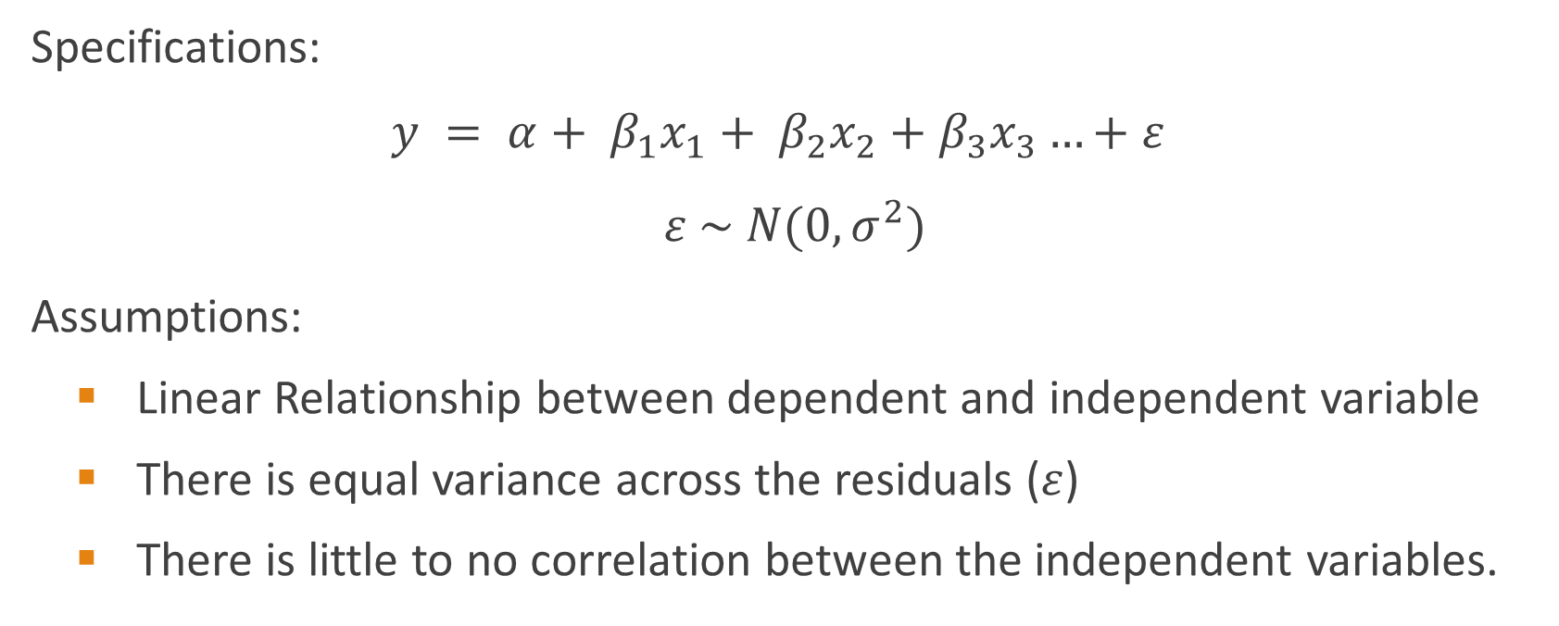
Recap – Multiple Regression
Specifications:
$$y = α+ β_{1}x_{1}+ β_{2}x_{2}+β_{3}x_{3}…+ε$$
$$ε \sim N(0,σ^{2})$$
Assumptions:
Linear Relationship between dependent and independent variable
There is equal variance across the residuals ($ε$)
There is little to no correlation between the independent variables.

Slide 4
Recap – Multiple Regression
Guiding questions:
Have I chosen a suitable regression specification?
Can I defend the statistical robustness of my analysis?
Can I make my model understandable to my family over dinner?

Slide 5
Recap – Multiple Regression
Guiding questions:
Have I chosen a suitable regression specification?
Is the regression adequate for my dataset?
What is the nature of my data? (Count, Concentration, Binary)
Do I have a lot of 0 values? Is that expected?
Are my transformation as appropriate?

Slide 6
Recap – Multiple Regression
Guiding questions:
Can I defend the statistical robustness of my analysis?
Have I checked the assumptions of my specification?
Can I make my model understandable to my family over dinner?

Slide 7
Two Additional Tools
What happens if you suspect there might be an important the relation between observations, or between variables?
What happens if I have a massive dataset and I am not sure when to start?

Slide 8
Principal Components Analysis
Multivariate technique.
Applicable (mostly) to continuous datasets.
Can reveal unexpected or underlying relations between variables.
Exploratory -> Its not a modelling technique itself.

Slide 9
Principal Components Analysis
Goals:
To reduce the number of dimensions needed
To maximize the variance in each dimension
How?

Slide 10
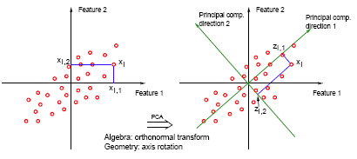
Principal Components Analysis
Goals:
To reduce the number of dimensions needed
To maximize the variance in each dimension
How?
Source: PSU

Slide 11
Principal Components Analysis
Step 1: Pre-process
Know your data
Aim for a ratio of Variable/Observation of about 5.
Transform if needed
Optional: Scale -> Can be done in directly in function.
Step 2: Calculate
Do the actual Principal Component Analysis
Select how many PC you want to keep
Step 3: Understand
Understand and interpret

Slide 12
Clustering
Another multivariate technique.
Applicable (mostly) to continuous datasets, but it can binary variables
Can reveal unexpected or underlying relations between observations
Exploratory -> Its not a modelling technique itself.
There are many types of clustering, here we will look at Hierarchical Clustering and k-clustering.

Slide 13
Hierarchical Clustering
Goals:
Creates cluster (Groups) of observations
Minimize the variance within groups.
How?

Slide 14
Hierarchical Clustering
Goals:
Creates cluster (Groups) of observations
Minimize the variance within groups.
How?
Aggregation based on distance between points in multivariate space.

Slide 15
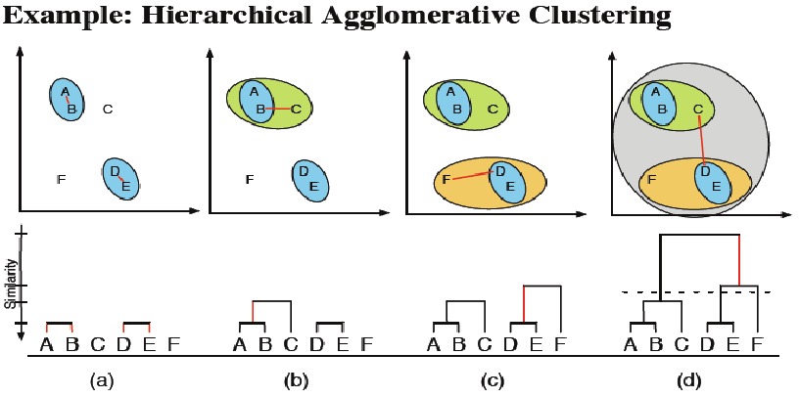
Hierarchical Clustering
Source: Janssen, P., Walther, C., & Lüdeke, M. (2012).

Slide 16
Hierarchical Clustering
Step 1: Pre-process.
Know your data
Scale the data [Method is not scale invariant]
Step 2: Calculate
Calculate the multivariate distance of the observations
Aggregate the observations based in a grouping method.
Select how many clusters you want to keep
Step 3: Understand
Understand and interpret

Slide 17
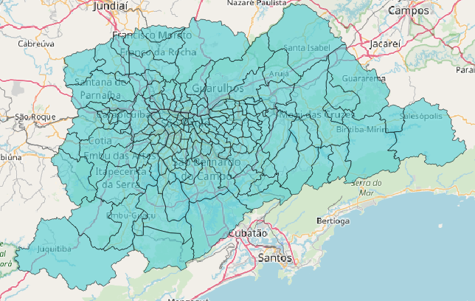
Applied Example
Data from Metropolitan Area of Sao Paulo including economic, social and environmental indicators.
18 variables for 162 districts in Sao Paulo Metro.
Go to the Markdown

Slide 18
